Slide 1
Todo List
2018975021 김현수

Slide 2
-목차
1. 초기화면
2-1. + 버튼
2-2. Select Icon
3. add item
4. Icon touch, Progress bar
5. delete item

Slide 3
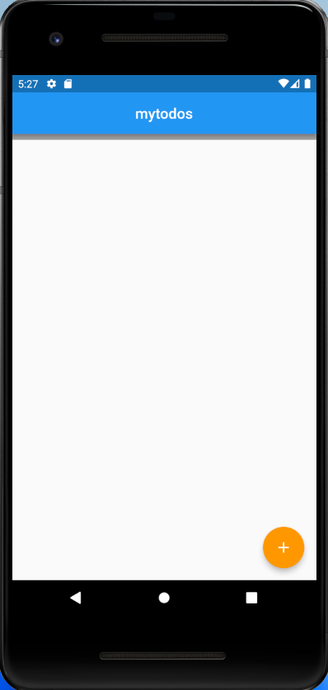
1. 초기화면

Slide 4
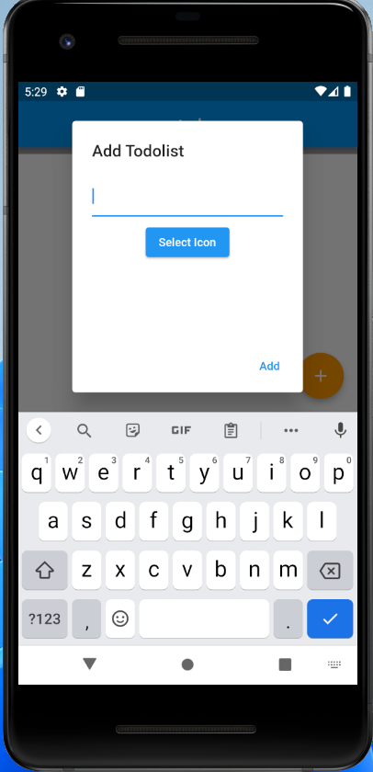
2-1. + 버튼

Slide 5
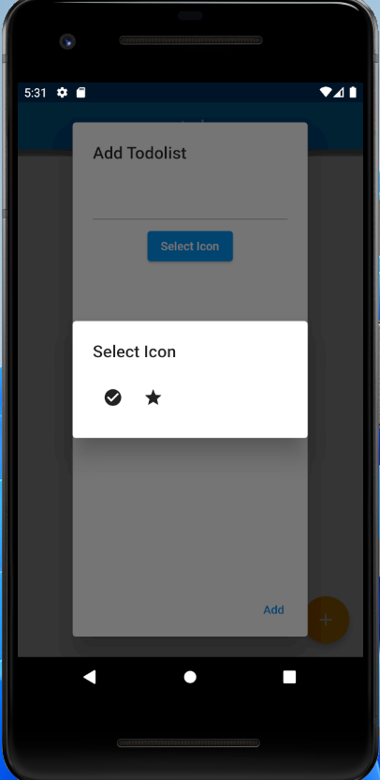
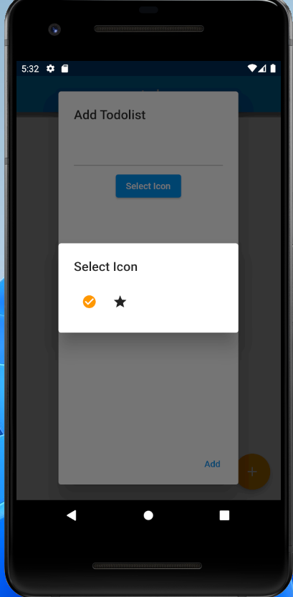
2-2. Select Icon

Slide 6
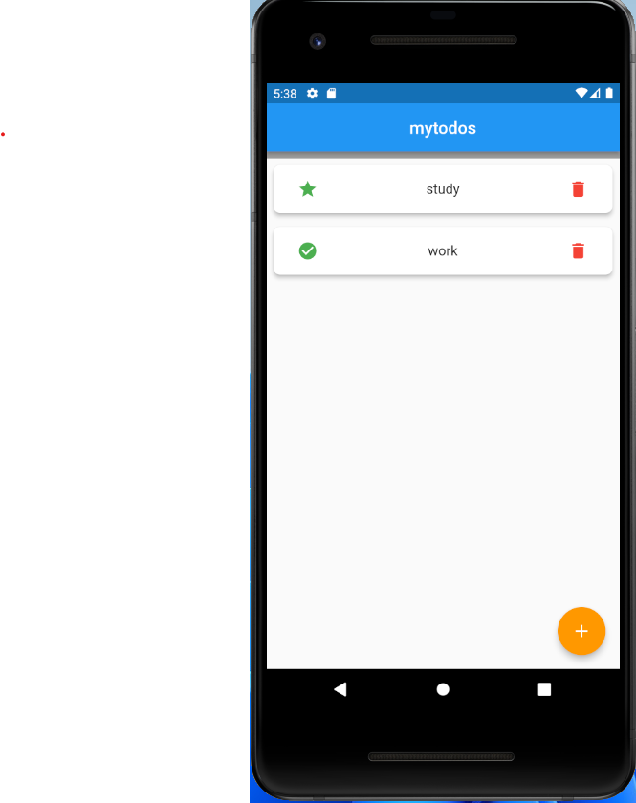
3. Add item

Slide 7
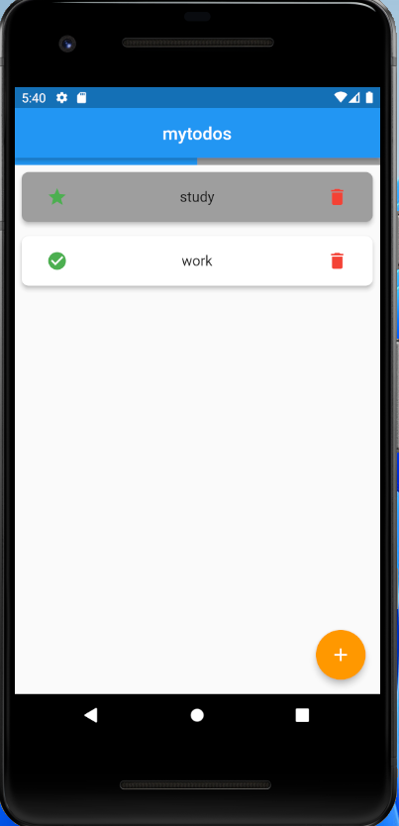
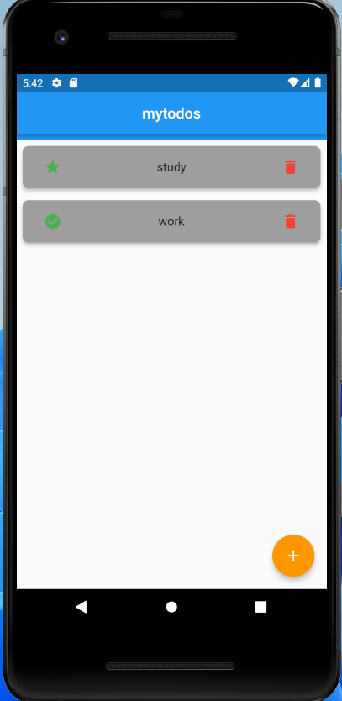
4. Icon touch, Progressbar

Slide 8
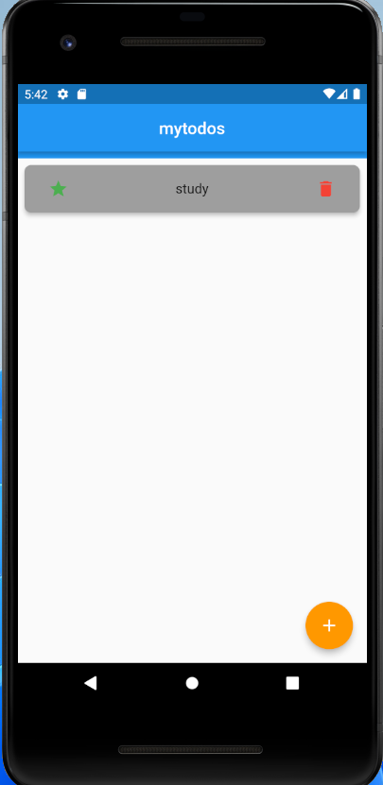
5. Delete item

Slide 9
3. 참조
https://developer0809.tistory.com/127
github repository
https://github.com/WeslySloan/html-bricks

